Slide 1

IRIS
SWEG Capstone 2016

Slide 2
Project Members
Scott Arnette
Joseph LaCava
Derek Ouzia
Bryan Smith

Slide 3
Project Overview
Iris is an application that will provide users the ability to be read emails received to the Google Accounts they choose to use during application use on a device running the Android operating system.
After being read an email, users will additionally be prompted whether to keep or delete the previously read message.

Slide 4
Project Planning
Project Development Plan.
Team Dynamics.
Project Documentation.
Project Risks.
Project Reporting.

Slide 5
Project Development Plan
Software Development Life Cycle
Planning.
Analysis.
Design.
Implementation.
Maintenance.

Slide 6
Team Dynamics
Work Design
Autonomy.
Skill Variety.
Composition
Ability.
Personality.
Roles and Diversity.
Size.
Flexibility.
Content
Adequate Resources.
Leadership.
Climate of Trust.
Process
Common Purpose and Goals.
Confidence.
Very low conflict level.

Slide 7
Project Documentation
Project Vision and Scope.
Software Requirements Specification Document.
Software Design Document.
Source Code.
Software Maintenance Records.

Slide 8
Project Risks
Identification of Project Risks.
Qualitative and Quantitative Risk Analysis.
Risk Response Planning.
Risk Monitoring and Control.

Slide 9
Project Reporting
Weekly Status Report.
Communication of project status to the project manager.
Identification of issues with the project.
Prompt planning and action.

Slide 10
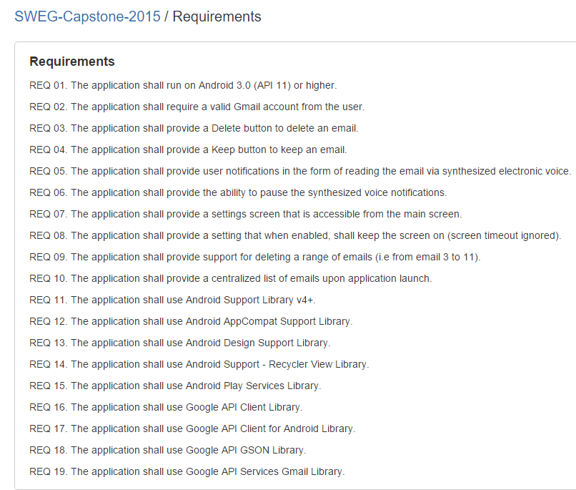
Requirements Elicitation
Client wanted Apple App
Wanted buttons to keep or delete a message as it was read.
Ability to stop or start the service.
Determine APIs and libraries needed.
Determine the minimum version of Android that supported APIs and libraries needed for development.

Slide 11
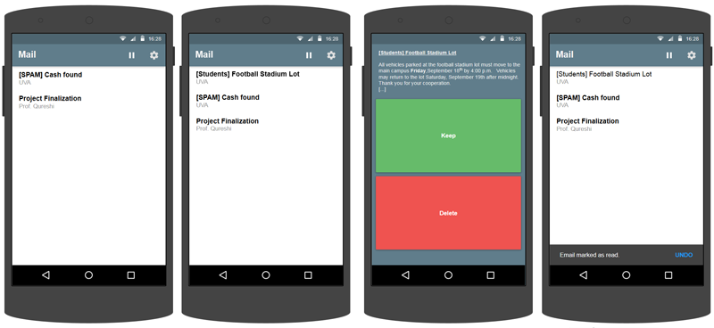
Design - 1st Semester

Slide 12
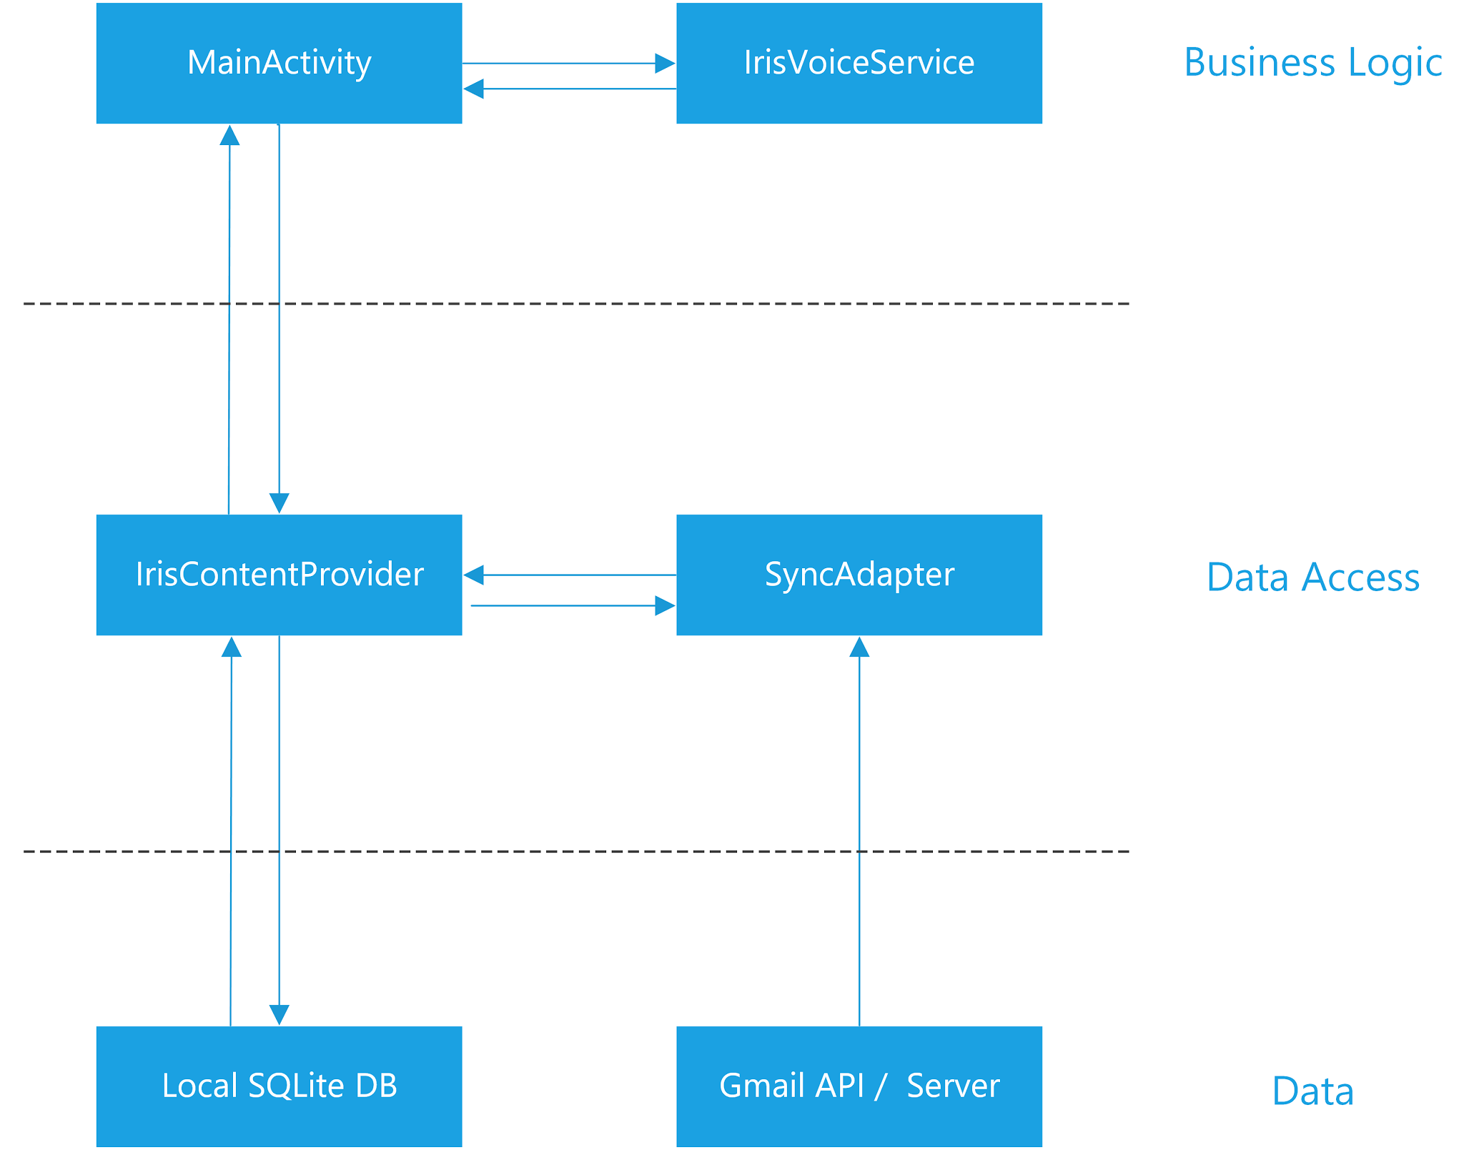
System Architecture
Divided into four main parts: business logic, data access, data, and views. Three of those parts are visible in the diagram here.
Business logic: What will the app do with data or input it receives?
Data Access: How will the application receive and manage data and input?
Data: Local and remote data sources or stores.
Views: How is the data displayed to the user?

Slide 13
Development - Technologies
Java - Main Programming Language
XML - Extensible Markup Language defines the UI views.
SVG - Scalable Vector Graphics for our images
Android SDK - Software Development Kit that integrates with Java to allow execution on Android Devices

Slide 14
Development - Libraries
Gmail API for Android
Google Play Services v8.3
Google Identity Library (Dependence of Gmail API)
Javax.Mail - Allowed for easily parsed email headers (find the sender etc)
Android Support Design Library v7 - Allowed backwards compatible design on older versions of Android
Android App Compat v23 - Allowed backwards compatible features on older versions of Android

Slide 15
New This Semester
Reviewed Project Schedule
Reviewed Project Requirements
Reviewed Project Risks
Add new feature requirements
Update design to accommodate new features

Slide 16
New Features
Support multiple Gmail Accounts
Second battery-saving sync frequency
Improve syncing logic
Bug Fixes

Slide 17
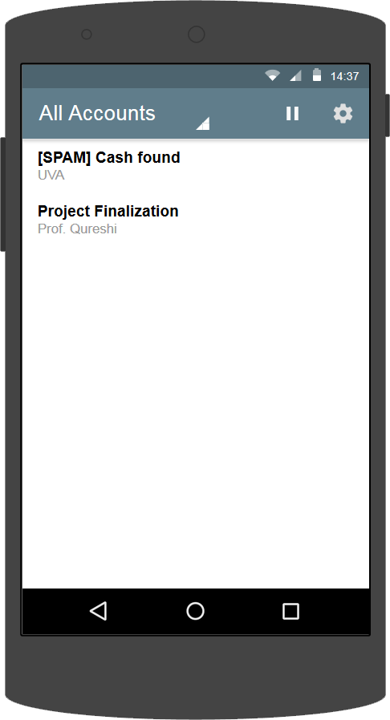
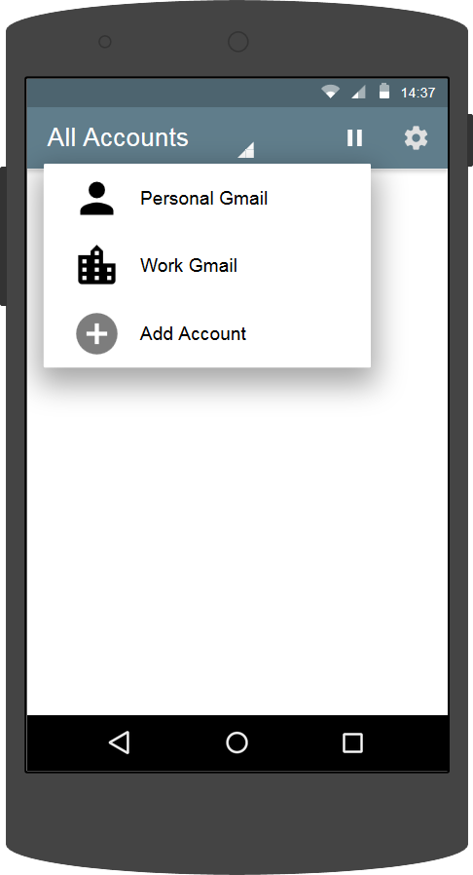
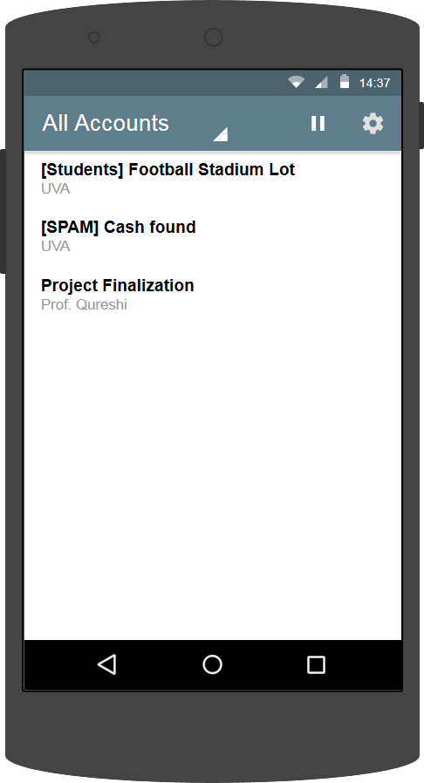
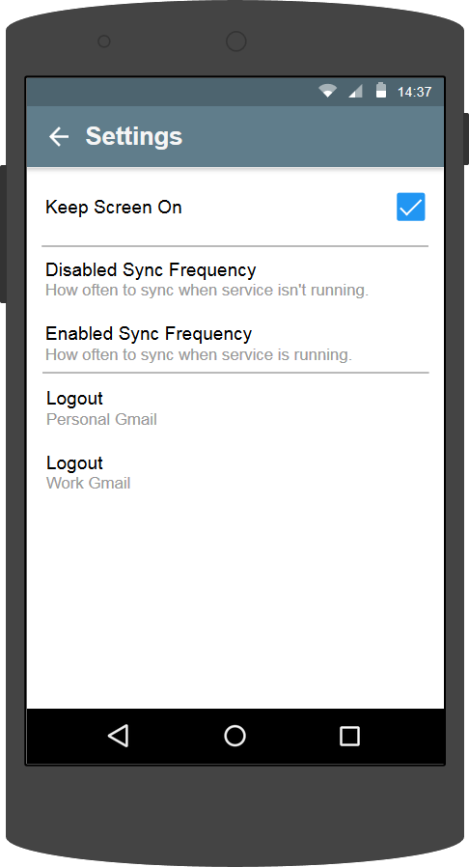
Design - 2nd Semester

Slide 18
Development - New Semester
Determine what would need to be changed, added, or removed to accommodate our new requirements.
We assumed most of the email sync logic would need to be re-designed to work with multiple accounts.
As we got into implementing multiple accounts, we found that we would be able to leave most of the sync code as-is. Android handled it itself smoothly.
Bulk of the changes were to the UI to accommodate logging in, out of, and selecting the multiple accounts.

Slide 19
Testing
Bulk of testing was from an independent testing team who were taking the Software Engineering course, Software Testing and Verification.
They started testing as we were finishing up development.
We followed up with our testing after resolving their findings, as to avoid duplicates.
After the independent testing team had executed their testing and those issues were resolved, the rest of the issues we found were mostly cosmetic UI issues.

Slide 20
Project Progression
Task | Duration | Date to be Started | Date to be Completed
Review and Requirements | 15 days | 1/12/2016 | 2/1/2016
Design/Risks | 10 days | 2/2/2016 | 2/15/2016
Development | 25 days | 2/16/2016 | 3/28/2016
Testing | 15 days | 3/29/2016 | 4/18/2016
Demo/Papers/Etc. | 6 days | 4/19/2016 | 4/26/2016
Application enhancement and testing is completed.
Project as initially defined by requirements is complete, with some features dropped due to time constraints.

Slide 21

Configuration Management
IBM ClearQuest Bug Tracking (Shared with independent testing team)
BitBucket as the code repository
Contains branches, wiki, change management, and issue tracking all in one location

Slide 22
Deployment & Maintenance
Published to the Google Play Store pending UVA Wise Approval
Can also be installed via APK file if the Google Play Store is not available.
No current plan to have continue support unless expanded on or maintained by a class.
Documentation has been developed giving detailed notes on requirements for distribution and updating.

Slide 23
Social Impacts
Can help users maintain important focus while simultaneously alerting them to new emails.
However, Iris still requires some touch interaction and should be used with caution.
Users should of course abide by all applicable laws (I.E Driving)
Email messages are never permanently deleted by Iris. (Only ‘trashed’)
Iris never has access to the user's password for their Gmail accounts. (Android OS Handles the account credentials)

Slide 24
Questions?

